Slide 1
Angular Architecture
k. Anju munoth

Slide 2
Anatomy of the Setup Project
File | Purpose
src/app/ | Angular application files go here. Ships with the "Hello Angular" sample's AppComponent, AppModule, a component unit test (app.component.spec.ts), and the bootstrap file, main.ts.
e2e/ | End-to-end (e2e) tests of the application, written in Jasmine and run by the protractor e2e test runner.
node_modules/ | The npm packages installed with the npm install command.
.editorconfig .git/ .gitignore .travis.yml | Tooling configuration files and folders.
package.json | Identifies npmpackage dependencies for the project. Contains command scripts for running the application, running tests, and more. Enter npm run for a listing.

Slide 3
Anatomy of the Setup Project
File | Purpose
CHANGELOG.md | The history of changes to the QuickStart repository. Delete or ignore.
favicon.ico | The application icon that appears in the browser tab.
index.html | The application host page. It loads a few essential scripts in a prescribed order. Then it boots the application, placing the root AppComponent in the custom <my-app> body tag. The same index.html satisfies all documentation application samples.
karma.conf.js | Configuration for the karma test runner
karma-test-shim.js | Script to run karma with SystemJS
non-essential-files.txt | A list of files that you can delete if you want to purge your setup of the original QuickStart Seed testing and git maintenance artifacts.

Slide 4
Anatomy of the Setup Project
File | Purpose
LICENSE | The open source MIT license to use this setup code in your application.
protractor.config.js | Configuration for the protractor end-to-end (e2e) test runner.
README.md | Instruction for using this git repository in your project.
styles.css | Global styles for the application. Initialized with an <h1> style for the QuickStart demo.
systemjs.config.js | Tells the SystemJS module loader where to find modules referenced in JavaScript import statements. For example: import { Component } from '@angular/core;
systemjs.config.extras.js | Optional extra SystemJS configuration. A way to add SystemJS mappings, such as for application barrels, without changing the original system.config.js.
tsconfig.json | Tells the TypeScript compiler how to transpile TypeScript source files into JavaScript files that run in all modern browsers.
tslint.json | The npm installed TypeScript linter inspects your TypeScript code and complains when you violate one of its rules.

Slide 5
Architecture
Angular is a framework for building client applications in HTML and either JavaScript or a language like TypeScript that compiles to JavaScript.
The framework consists of several libraries, some of them core and some optional.
Can write Angular applications by composing HTML templates with Angularized markup, writing component classes to manage those templates, adding application logic in services, and boxing components and services in modules.
Then can launch the app by bootstrapping the root module.
Angular takes over, presenting application content in a browser and responding to user interactions according to the instructions provided.

Slide 6
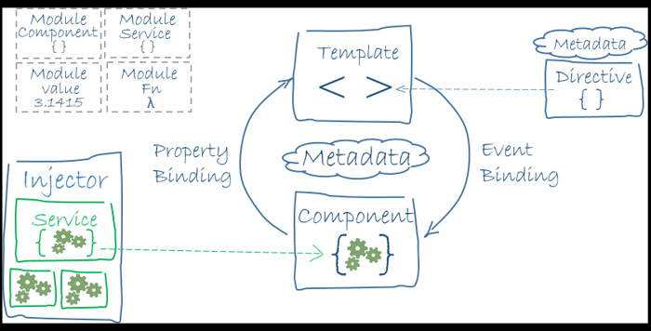
Angular application

Slide 7
Angular application
Eight main building blocks of an Angular application:
Modules
Components
Templates
Metadata
Data binding
Directives
Services
Dependency injection

Slide 8
Modules
Angular apps are modular and Angular has its own modularity system called NgModules.
Every Angular app has at least one NgModule class, the root module, conventionally named AppModule.
While the root module may be the only module in a small application, most apps have many more feature modules, each a cohesive block of code dedicated to an application domain, a workflow, or a closely related set of capabilities.
An NgModule, whether a root or feature, is a class with an @NgModule decorator.
Decorators are functions that modify JavaScript classes. Angular has many decorators that attach metadata to classes so that it knows what those classes mean and how they should work

Slide 9
NgModule
NgModule is a decorator function that takes a single metadata object whose properties describe the module.
The most important properties are:
declarations - the view classes that belong to this module. Angular has three kinds of view classes: components, directives, and pipes.
exports - the subset of declarations that should be visible and usable in the component templates of other modules.
imports - other modules whose exported classes are needed by component templates declared in this module.
providers - creators of services that this module contributes to the global collection of services; they become accessible in all parts of the app.
bootstrap - the main application view, called the root component, that hosts all other app views. Only the root module should set this bootstrap property.

Slide 10
Components
A component controls a patch of screen called a view.
Can define a component's application logic—what it does to support the view—inside a class.
Class interacts with the view through an API of properties and methods.

Slide 11
Templates
Can define a component's view with its companion template.
A template is a form of HTML that tells Angular how to render the component.
A template looks like regular HTML, except for a few differences
Although the template uses typical HTML elements like <h2> and <p>, it also has some differences. Code like *ngFor, {{}}, (click), [hero], and <hero-detail> uses Angular's template syntax.

Slide 12
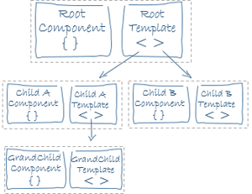
Templates

Slide 13
Metadata
Metadata tells Angular how to process a class.
To tell Angular that class is a component, attach metadata to the class.
In TypeScript, can attach metadata by using a decorator

Slide 14
@Component decorator
Identifies the class immediately below it as a component class.
The @Component decorator takes a required configuration object with the information Angular needs to create and present the component and its view.
Most useful @Component configuration options:
selector: CSS selector that tells Angular to create and insert an instance of this component where it finds a <hero-list> tag in parent HTML. For example, if an app's HTML contains <hero-list></hero-list>, then Angular inserts an instance of the HeroListComponent view between those tags.
templateUrl: module-relative address of this component's HTML template
providers: array of dependency injection providers for services that the component requires.

Slide 15
Decorator
The metadata in the @Component tells Angular where to get the major building blocks to specify for the component.
The template, metadata, and component together describe a view.
Apply other metadata decorators in a similar fashion to guide Angular behavior. @Injectable, @Input, and @Output are a few of the more popular decorators.

Slide 16
Data binding
Angular supports data binding, a mechanism for coordinating parts of a template with parts of a component.
Add binding markup to the template HTML to tell Angular how to connect both sides.
There are four forms of data binding syntax.
Each form has a direction — to the DOM, from the DOM, or in both directions.

Slide 17
Data binding
The {{hero.name}} interpolation displays the component's hero.name property value within the <li> element.
The [hero] property binding passes the value of selectedHero from the parent HeroListComponent to the hero property of the child HeroDetailComponent.
The (click) event binding calls the component's selectHero method when the user clicks a hero's name.
Two-way data binding is an important fourth form that combines property and event binding in a single notation, using the ngModel directive.
In two-way binding, a data property value flows to the input box from the component as with property binding. The user's changes also flow back to the component, resetting the property to the latest value, as with event binding.

Slide 18
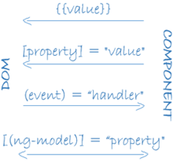
Data binding

Slide 19
Data binding
<li>{{hero.name}}</li>
<app-hero-detail [hero]="selectedHero"></app-hero-detail>
<li (click)="selectHero(hero)"></li>
<input [(ngModel)]="hero.name">

Slide 20
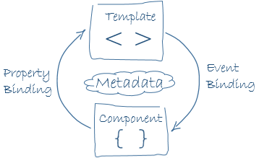
Data binding

Slide 21
Directives
Angular templates are dynamic. When Angular renders them, it transforms the DOM according to the instructions given by directives.
A directive is a class with a @Directive decorator.
A component is a directive-with-a-template; a @Component decorator is actually a @Directive decorator extended with template-oriented features.
While a component is technically a directive, components are so distinctive and central to Angular applications that this architectural overview separates components from directives.
Two other kinds of directives exist: structural and attribute directives.
They tend to appear within an element tag as attributes do, sometimes by name but more often as the target of an assignment or a binding.
Structural directives alter layout by adding, removing, and replacing elements in DOM.

Slide 22
structural directives
<li *ngFor="let hero of heroes"></li>
<app-hero-detail *ngIf="selectedHero"></app-hero-detail>
*ngFor tells Angular to stamp out one <li> per hero in the heroes list.
*ngIf includes the HeroDetail component only if a selected hero exists.

Slide 23
Attribute directives
Attribute directives alter the appearance or behavior of an existing element.
In templates they look like regular HTML attributes, hence the name.
The ngModel directive, which implements two-way data binding, is an example of an attribute directive.
ngModel modifies the behavior of an existing element (typically an <input>) by setting its display value property and responding to change events.

Slide 24
Services
Service is a broad category encompassing any value, function, or feature that application needs.
Almost anything can be a service. A service is typically a class with a narrow, well-defined purpose. It should do something specific and do it well.
Examples include:
logging service
data service
message bus
tax calculator
application configuration
Components are big consumers of services.

Slide 25
Services
Services are everywhere.
Component classes should be lean. They don't fetch data from the server, validate user input, or log directly to the console. They delegate such tasks to services.
A component's job is to enable the user experience and nothing more. It mediates between the view (rendered by the template) and the application logic (which often includes some notion of a model).
A good component presents properties and methods for data binding. It delegates everything nontrivial to services.
Angular doesn't enforce these principles.
Angular does help you follow these principles by making it easy to factor your application logic into services and make those services available to components through dependency injection.

Slide 26
Dependency injection
Dependency injection is a way to supply a new instance of a class with the fully-formed dependencies it requires.
Most dependencies are services. Angular uses dependency injection to provide new components with the services they need.
Angular can tell which services a component needs by looking at the types of its constructor parameters.
When Angular creates a component, it first asks an injector for the services that the component requires.
An injector maintains a container of service instances that it has previously created.
If a requested service instance is not in the container, the injector makes one and adds it to the container before returning the service to Angular.
When all requested services have been resolved and returned, Angular can call the component's constructor with those services as arguments. This is dependency injection.

Slide 27
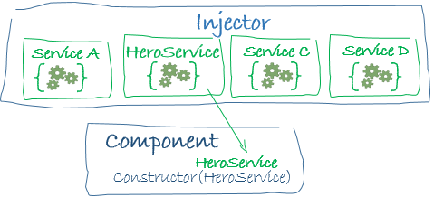
Dependency injection

Slide 28
Dependency injection
Dependency injection is wired into the Angular framework and used everywhere.
The injector is the main mechanism.
An injector maintains a container of service instances that it created.
An injector can create a new service instance from a provider.
A provider is a recipe for creating a service.
Register providers with injectors.
Can register providers in modules or in components.
In general, add providers to the root module so that the same instance of a service is available everywhere.
Alternatively, register at a component level in the providers property of the @Component metadata
Registering at a component level means you get a new instance of the service with each new instance of that component

